Slide 1
Generalized Linear Models
Generalized linear models, GLMs, describe patterns of association and interaction.
The models help us evaluate which explanatory variables affect the response, while controlling for effects of possible confounding variables.
For instance, ordinary least squares regression is a GLM.

Slide 2
Components of a GLM
Random component: identifies the response variable Y and assumes a probability distribution for it.
Systematic component: specifies the explanatory variables for the model.
Link Function: specifies a function of the expected value of Y, which the GLM relates to the explanatory variables through a prediction equation which has a linear form.

Slide 3
Random component
The Random component identifies the response variable Y and selects a probability distribution for it.
If we have binary data, such as “success” or “failure”, we typically use a Bernoulli distribution with success probability π.
If Y is the number of successes out of a certain number of trials, we use a Binomial.
For count data we use a Poisson and for continuous data we might use a Normal.

Slide 4

Systematic component
The systematic component specifies the explanatory (independent) variables for the model.
These enter linearly as predictors on the right hand side of the model equation – specifies the {x_{j}} in
The linear combination of explanatory variables is called the linear predictor

Slide 5

Link Function
The link function is the function g(•) that relates the expected value of Y, the mean of Y, to the linear predictor.
It is the “link” between the random and systematic components. It shows how E(Y) relates to the explanatory variables.
Note, in general we denote the mean of Y as μ. This is also the same as the expected value of Y. Thus we have that E{Y}= μ. We then model some function of μ.

Slide 6
Link Function
The simplest link function is the identity function where g(μ) = μ.
Other links allow the mean to be nonlinearly related to predictors. For example if g(μ)=log(μ), then

Slide 7
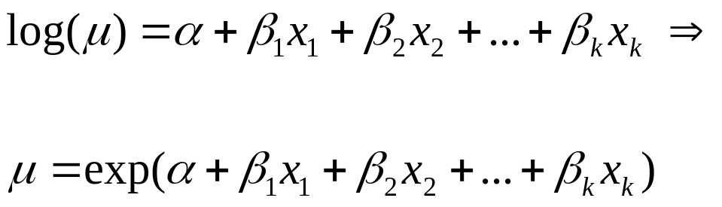
Link Function
The log link is only appropriate when µ can not be negative, such as count data.
Using the log link is called the loglinear model and note
Thus, the mean is nonlinear

Slide 8
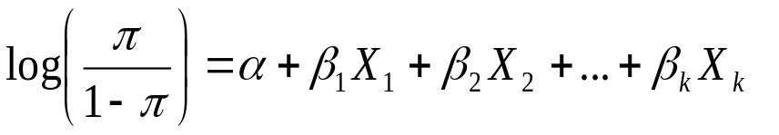
Link Function
To model the log of an odds, we use the logit link:
g(π) =log (π /1- π)
We are using π in place of μ because we are considering Y to be a Bernoulli random variable, where the expected value of Y is π, the probability of success.

Slide 9
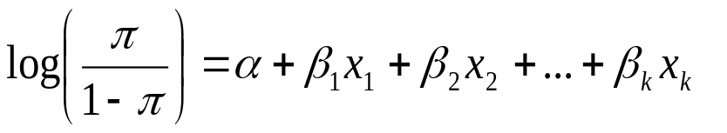
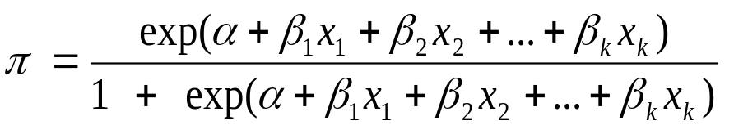
Link Function
Again, using the logit link on π to relate π to the explanatory variables gives
This is used in logistic regression and note that

Slide 10
GLM
Ordinary regression for continuous responses is a specific type of GLM.
GLM generalizes ordinary regression in 2 ways:
The data does not have to follow a normal distribution
It allows modeling of some function of the mean.
Estimates of parameters are found using maximum likelihood methods.

Slide 11
Poisson distribution
The Poisson distribution has 1 parameter(μ), the mean.
Y is a random variable and we denote observed values in lower case, y.
So if we are modeling the number of cookies my son eats, and we observe him eat 5, we have that y=5.
The Poisson probability distribution can be used to give the probability that Y=5, that is the probability that we observe 5 cookies eaten.

Slide 12
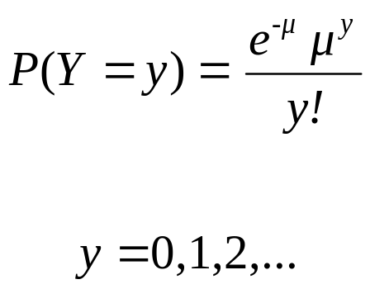
Poisson distribution
The Poisson probability distribution of Y (the probability that Y=y) is
R code: probability distribution

Slide 13
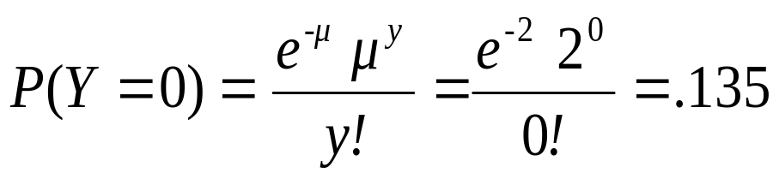
Poisson distribution
Suppose eating cookies follows a Poisson distribution and occur at the average rate of 2 per week. Then Y, the number of cookies eaten in a week, is Poisson and the mean is 2 (μ=2).
What is the probability of observing no cookies eaten in a week, P(Y=0).

Slide 14
Poisson distribution
For a poisson random variable, E(Y) = μ.
We also have that σ²(Y) = μ.
That is, for a poisson random variable, the variance is the same as the mean.

Slide 15
Poisson distribution
If eating cookies is truly constant over time with an expected two cookies eaten per week, than in the long run:
The counts of cookies eaten in our data should have a sample mean of 2.
And a sample variance of 2.
Note the variance increases as the mean increases.

Slide 16
Poisson distribution
In practice, count observations often have a variance that is greater than the mean.
This is called overdispersion.
The poisson may be too simplistic a model for our data.
Typically, if there is overdispersion with count data, the Negative Binomial distribution is used.

Slide 17


Poisson Regression
Poisson regression is used to model count data. The values of a Poisson variable are nonnegative, so we use a log link.
The mean is then
A one unit increase in X has a multiplicative impact of exp(β) on µ. That is for a one unit increase in x, µ increases multiplicatively by exp(β).

Slide 18
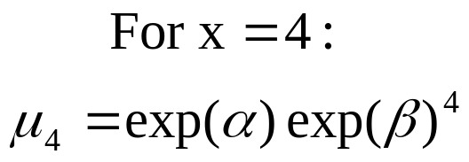
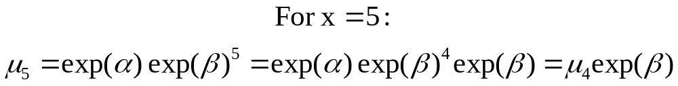
Poisson Regression
Consider the value of the mean for x=5, say μ₅, and for x=4, say μ₄.

Slide 19
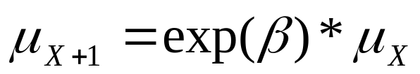
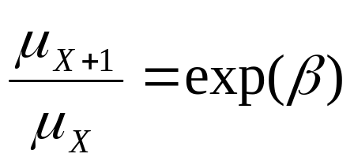
Poisson Regression
In general,
The mean increases multiplicatively by exp(β) for every unit increase in X. Rearranging the terms, we also have that
Thus exp(β) is the ratio of means for a one unit increase in X.

Slide 20
Poisson Regression
Thus exp(β) can be interpreted as the multiplicative effect on µ for a one unit increase in X.
This is often interpreted as that exp(β) equals the ratio of the means for a one unit increase in X.
If β=0, µ=exp(α) for any value of X and X and Y are independent.
If β>0, the mean increases as X increases. Similarly, if β< 0, the mean decreases as X increases.

Slide 21
Poisson Regression
Crab data: Each female crab in the study had a male crab attached to her in the nest.
The study investigated factors that affect whether the female crab had any other males, called satellites, residing nearby.
Explanatory variables include color of the crab, age, and shell width.
For now, we will consider shell width, which is a summary of the crab’s size.

Slide 22

Poisson Regression
Y is the number of satellites and X is the width, which is continuous.
Letting µ denote the expected number of satellites, the fit of the Poison regression model is
The estimated coefficient for width β(hat)=.164 has a standard error of .02.
Since β(hat)>0, width has a positive estimated effect on the number of satellites.

Slide 23
Poisson Regression
The estimated mean number of satellites, µ(hat), at the mean width (26.3) is
Without using the prediction equation, what is the estimated mean number of satellites for width of 27.3?

Slide 24
Poisson Regression
Exp(β(hat))=exp(.164)=1.18. Thus the mean number of satellites at x=27.3 equals the mean number of satellites at x=26.3 times 1.18.
1.18*2.74 = 3.23. Verifying, we have
Exp(β(hat)) =1.18 represents the multiplicative effect on the estimated value of the mean for a 1 unit increase in X. A 1 cm increase in width has an 18% increase in the estimated mean number of crabs.
We can also say that exp(β(hat)) =1.18 is the ratio of means for a one unit increase in width.

Slide 25
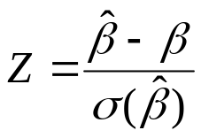
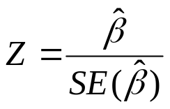
Poisson Regression
Since β(hat) is an mle, it is distributed normal and we have that
follows a standard normal distribution.
To test if width has an effect on the mean number of satellites, the null is H_{o}: β = 0. Our test statistic, which uses the estimated standard error of β(hat), is then

Slide 26
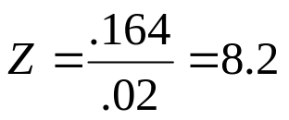
Poisson Regression
Note, even though the standard error of β(hat) is estimated, we still use the z distribution and not the t.
Often, the chi-square distribution is used for this test (such as with SAS). When the z statistic is squared, this gives a chi-square statistic with 1 degree of freedom.
For the crab example we have that
The chi-square statistic equals z squared which is 8.2^2=67.24. Both statistics will give the exact same p-value which here is <.0001.

